Slide 1
Degrees and minutes
Explicit teaching

Slide 2
How far around is 1 degree
Visible learning
Learning intentions
To understand the concept of an angle as a measure of turning.
To be able to use angles measured in degrees and minutes when solving problems.
Success criteria
I can describe what a particular angle looks like as a measure of turning.
I can convert an angle represented as a decimal into degrees and minutes.
I can solve problems involving finding missing sides in right-angled triangles, with angles represented in degrees and minutes.

Slide 3
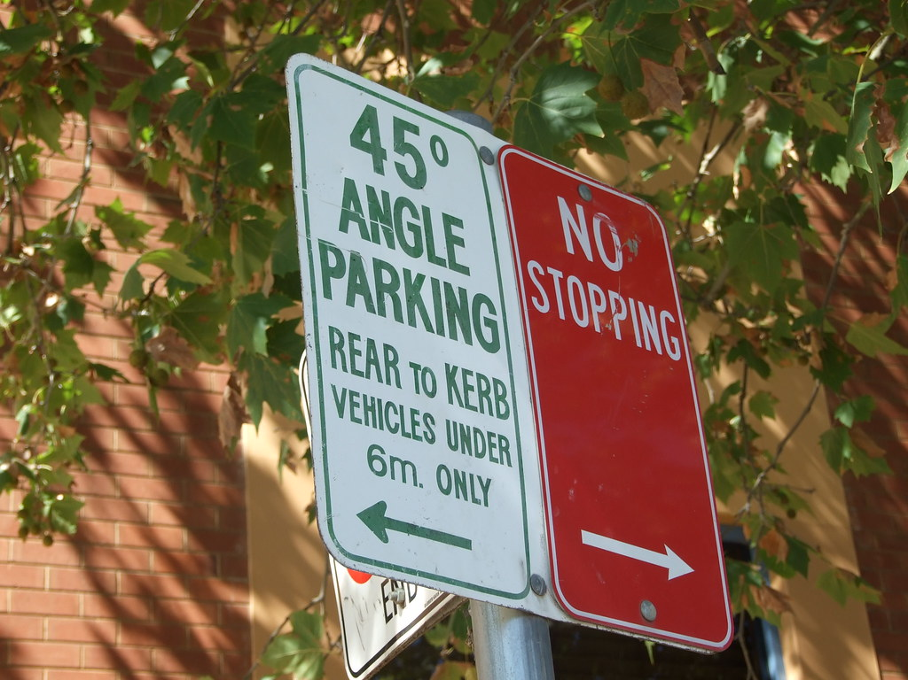
Estimating angles
Launch
Figure 1 - This Photo by Unknown Author is licensed under CC BY-SA
Notes:
Discuss with students the meaning of the 45 degree angle sign

Slide 4
Degrees and minutes – part 1
Converting decimal form to degrees and minutes
Worked example
Convert the angle ${3.5}^{°}$ to degrees and minutes.
$$0.5 ×60=30$$
$$∴3.5°=3°{30}^{′}$$
Why was 0.5 multiplied by 60?
0.5 represents part of a degree and forms the minutes.
60 minutes = 1 degree
What might the ‘ symbol represent?
minutes
Your turn
Convert the angle $1{3.1}^{°}$ to degrees and minutes.
$$0.1 ×60=6$$
$$∴13.1°=13°6^{′}$$
Notes:
Worked example:
Reveal the question and its solution
Students read in silence
Students explain to themselves what is happening in the examples
Thumb up when finished reading
Explain to a partner
Answer self-explanation questions
Share answers with whole class
Your turn:
Students now try this example on their own.
Give them time before revealing the answers.

Slide 5
Converting between forms – part 1
Converting a decimal form to degrees and minutes
Worked example
Convert the angle $61.25°$ to degrees and minutes.
$$0.25 ×60=15$$
$$∴61.25°=61°{15}^{′}$$
Why was 0.25 multiplied by 60?
0.25 represents part of a degree and forms the minutes.
60 minutes = 1 degree
Your turn
Convert the angle $158.75°$ to degrees and minutes.
$$0.75 ×60=45$$
$$∴158.75°=158°{45}^{′}$$
Notes:
Worked example:​
Reveal the question and its solution​
Students read in silence​
Students explain to themselves what is happening in the examples​
Thumb up when finished reading​
Explain to a partner​
Answer self-explanation questions​
Share answers with whole class​
​
Your turn:​
Students now try this example on their own. ​
Give them time before revealing the answers. ​

Slide 6
Degrees and minutes – part 2
Converting degrees and minutes to decimal form
Worked example
Convert the angle $39°{30}^{′}$ to decimal form.
$$\frac{30}{60}=0.5$$
$$∴39°{30}^{′}=39.5°$$
Why was 30 divided by 60?
30 represents 30 minutes out of the total 60 minutes in one degree
Your turn
Convert the angle $86°6^{′}$ to decimal form.
$$\frac{6}{60}=\frac{1}{10}=0.1$$
$$∴86°6^{′}=86.1°$$
Notes:
Worked example:​
Reveal the question and its solution​
Students read in silence​
Students explain to themselves what is happening in the examples​
Thumb up when finished reading​
Explain to a partner​
Answer self-explanation questions​
Share answers with whole class​
​
Your turn:​
Students now try this example on their own. ​
Give them time before revealing the answers. ​
​

Slide 7
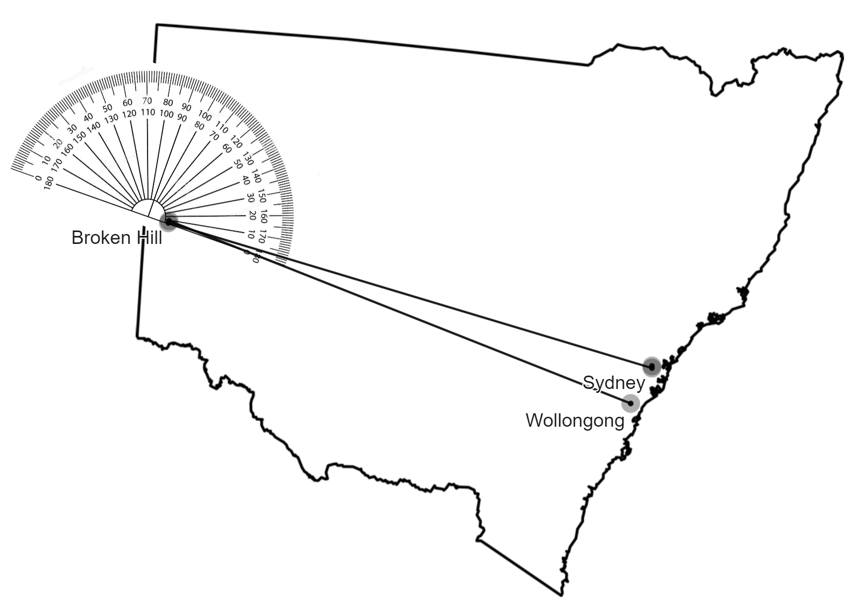
Converting between forms – part 2
Converting degrees and minutes to decimal form.
Worked example
Convert the angle $123°{15}^{′}$ to decimal form.
$$\frac{15}{60}=0.25$$
$$∴123°{15}^{′}=123.25°$$
How did this answer come about?
$\frac{15}{60}=\frac{1}{4}$ and $\frac{1}{4}=0.25$
Your turn
Convert $36°{45}^{′}$ to decimal form.
$$\frac{45}{60}=\frac{3}{4}=0.75$$
$$∴36°{45}^{′}=36.75°$$
Notes:
Worked example:​
Reveal the question and its solution​
Students read in silence​
Students explain to themselves what is happening in the examples​
Thumb up when finished reading​
Explain to a partner​
Answer self-explanation questions​
Share answers with whole class​
​
Your turn:​
Students now try this example on their own. ​
Give them time before revealing the answers. ​

Slide 8
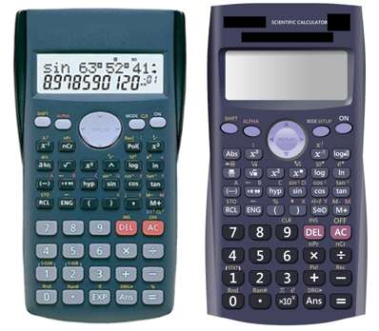
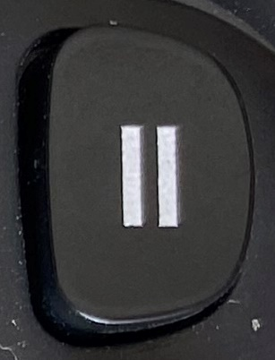
The calculator button
Using the calculator
Worked example
Using your calculator convert $18.2°$ to degrees and minutes.
Type
Press
$$∴18.2°=18°{12}^{′}$$
What might this button on your calculator represent?
Your turn
Convert $175.3°$ to degrees and minutes.
$$175.3°=175°{18}^{′}$$
Notes:
Worked example:​
Reveal the question and its solution​
Students read in silence​
Students explain to themselves what is happening in the examples​
Thumb up when finished reading​
Explain to a partner​
Answer self-explanation questions​
Share answers with whole class​
​
Your turn:​
Students now try this example on their own. ​
Give them time before revealing the answers. ​
​

Slide 9
Using the calculator
Using the calculator
Worked example
Using your calculator convert $135°{48}^{′}$ to decimal form.
Type
Press
$$∴135°{48}^{′}=135.8°$$
Why was this button used twice?
Your turn
Convert $72°{24}^{′}$ to decimal form.
$$72°{24}^{′}=72.4°$$
Notes:
Worked example:​
Reveal the question and its solution​
Students read in silence​
Students explain to themselves what is happening in the examples​
Thumb up when finished reading​
Explain to a partner​
Answer self-explanation questions​
Share answers with whole class​
​
Your turn:​
Students now try this example on their own. ​
Give them time before revealing the answers. ​

Slide 10
Success criteria
I can convert decimal form to degrees and minutes using my calculator.
I can convert from degrees and minutes to decimal form using my calculator.
I can convert between decimal form and degrees and minutes without my calculator.

