Slide 1
Solving trigonometric equations
Explicit teaching
Notes:
Worked example:
Reveal the question and its solution
Students read in silence
Students explain to themselves what is happening in the examples
Thumb up when finished reading
Explain to a partner
Answer self-explanation questions
Share answers with whole class
Your turn
Students now try this example on their own.
Give them time before revealing the answers.

Slide 2
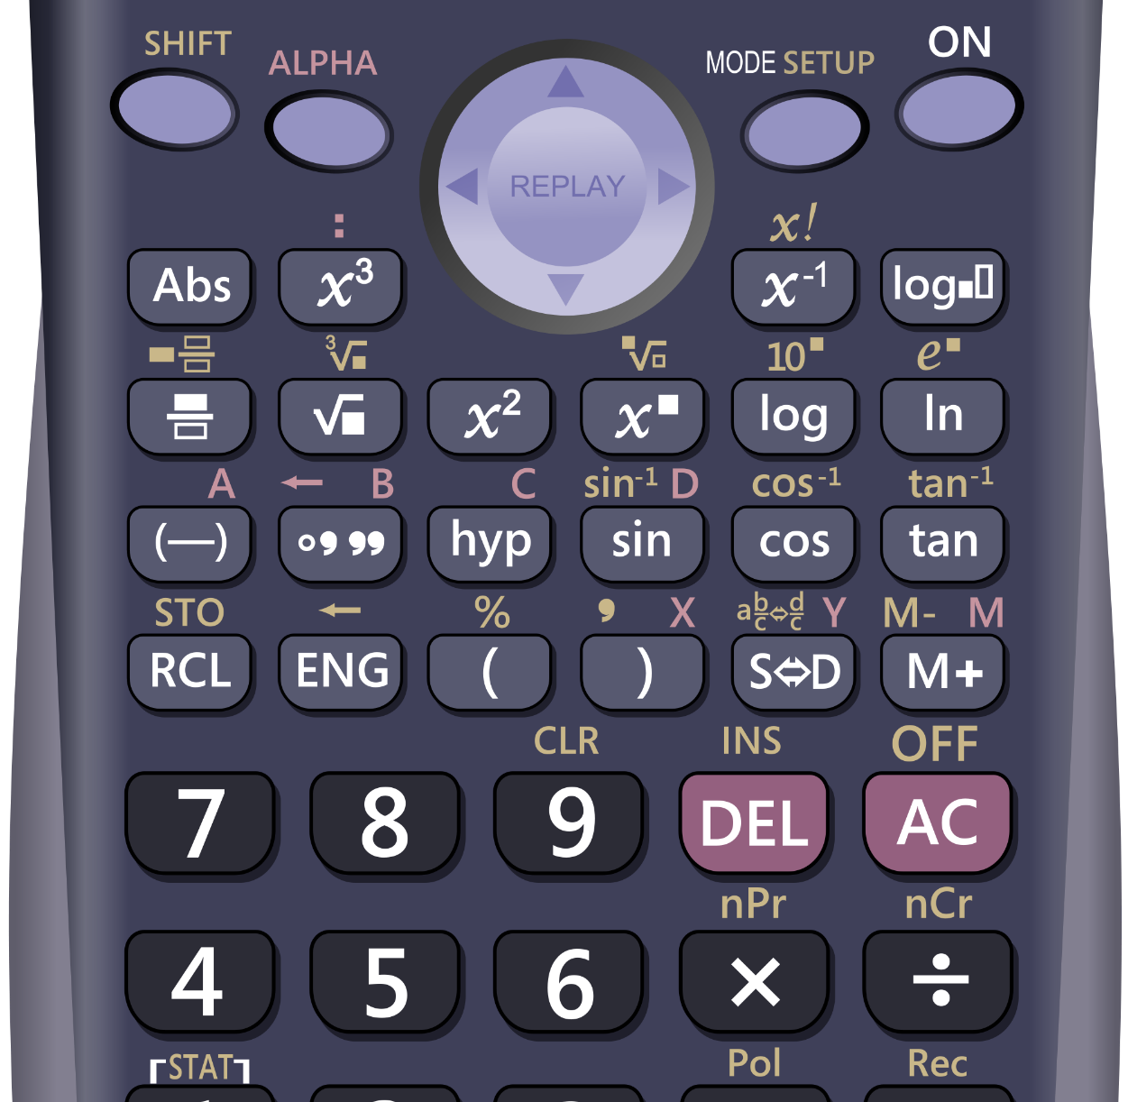

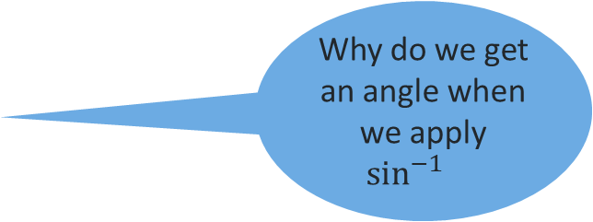

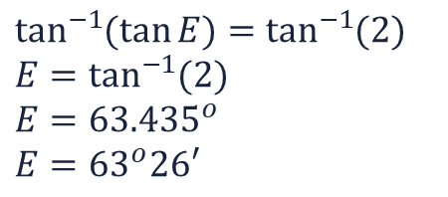
Solving trigonometric equations – part 1
Solutions to trigonometric equations
What is $\sin^{−1}{}$ doing?
Worked example
Solve $\sin{(A)}=0.87$
$\sin^{−1}{}$ works to “undo” $\sin{}$
SHIFT
SIN
$$\sin^{−1}{(\sin{A)=\sin^{−1}{(0.87)}} }$$
$$A=\sin^{−1}{(0.87)}$$
$$A= {60}^{°}$$
Why do we get an angle when we apply $\sin^{−1}{}$
$\sin{}$ takes an angle and gives a value. $\sin^{−1}{}$ takes a value and gives an angle.
Your turn
Solve $\tan{(E)}=2$
$$\tan^{−1}{(\tan{E})}=\tan^{−1}{(2)}$$
$$E=\tan^{−1}{(2)}$$
$$E={63.435}^{o}$$
$$E={63}^{o}26′$$
This Photo by Unknown Author is licensed under CC BY-NC
2
Notes:
Worked example:
Reveal the question and its solution
Students read in silence
Students explain to themselves what is happening in the examples
Thumb up when finished reading
Explain to a partner
Answer self-explanation questions
Share answers with whole class
Your turn
Students now try this example on their own.
Give them time before revealing the answers.

Slide 3
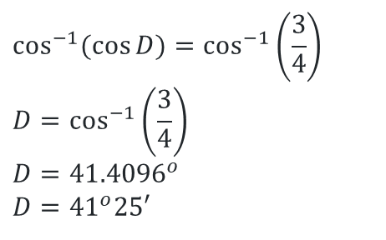

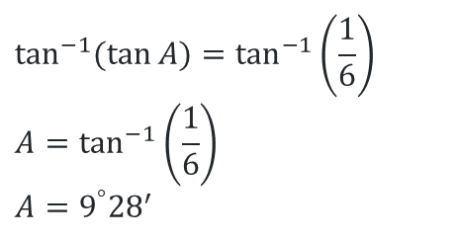
Solving trigonometric equations – part 2
Solutions to trigonometric equations
Worked example
What is $\tan^{−1}{}$ doing?
Solve $\tan\left(B\right)=\frac{1}{6}$
$\tan^{−1}{}$ works to “undo” $\tan{}$
SHIFT
TAN
$$\tan^{−1}{(\tan{A)=\tan^{−1}\left(\frac{1}{6}\right)}}$$
$$A=\tan^{−1}\left(\frac{1}{6}\right)$$
$$A=9^{°}{28}^{′}$$
How do we convert the angle to degrees and minutes?
Your turn
Solve $\cos{D=\frac{3}{4}}$
$$\cos^{−1}{(\cos{D})}=\cos^{−1}\left(\frac{3}{4}\right)$$
$$D=\cos^{−1}\left(\frac{3}{4}\right)$$
$$D={41.4096}^{o}$$
$$D={41}^{o}25′$$
This Photo by Unknown Author is licensed under CC BY-NC
3
Notes:
Worked example:
Reveal the question and its solution
Students read in silence
Students explain to themselves what is happening in the examples
Thumb up when finished reading
Explain to a partner
Answer self-explanation questions
Share answers with whole class
Your turn
Students now try this example on their own.
Give them time before revealing the answers.

Slide 4
Success criteria
I can solve trigonometric equations using the inverse trigonometric functions on a calculator.

