Slide 1
Larger and smaller angles
Explicit teaching

Slide 2
Larger and smaller angles – part 1
Visible learning
    Learning intentions
To be able to explain that the ratio between sides of a right-angled triangle remains the same if the angle is the same, regardless of size.
To be able to use ratios to find the heights of objects.
    Success criteria
I can use a clinometer to find positions that give desired angles towards tall objects.
I can use ratios in right-angled triangles to predict the heights of objects.

Slide 3
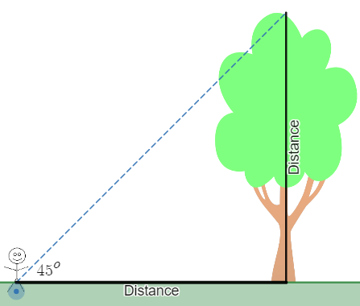
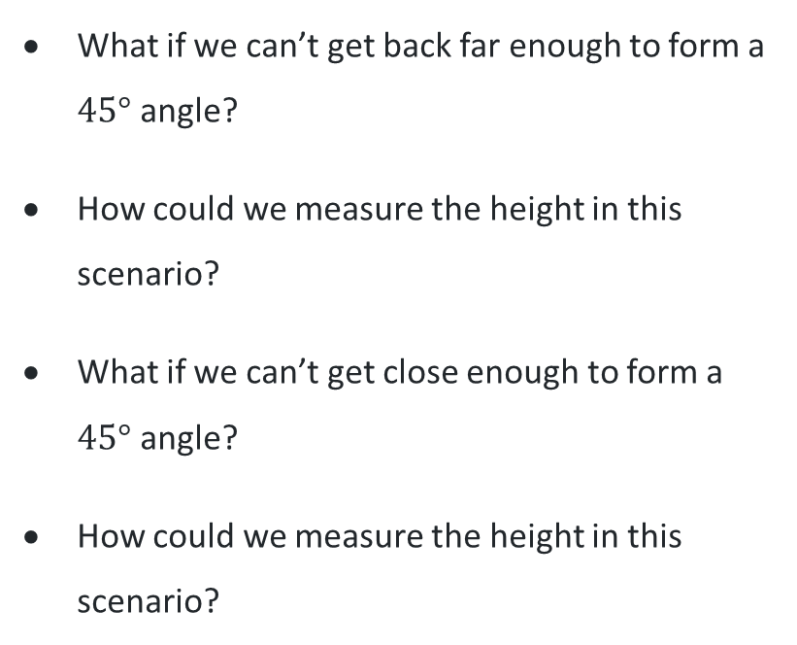
Larger and smaller angles – part 2
Think pair share
Launch
What if we can’t get back far enough to form a $45°$ angle?
How could we measure the height in this scenario?
What if we can’t get close enough to form a $45°$ angle?
How could we measure the height in this scenario?
Notes:
Review the previous lesson outcome: we discovered that if we find a position where the angle to the top of a tree is ${45}^{o}$, then the height of the tree is equal to the distance to the tree(which we can easily measure).
Use strategies such as Think, Pair, Share (bit.ly/thinkpairsharestrategy) to discuss the question, "what if we can't get back to form a ${45}^{o}$ angle. How could you measure the height in this scenario?"
The scenario can be displayed in this Desmos graph, Larger angles scenario (bit.ly/desmoslargeranglesscenario). Ask students: What happens to the angle as we move closer to the tree? What happens to the ratio of the two sides?
Similarly, use strategies such as Think, Pair, Share (bit.ly/thinkpairsharestrategy) to discuss the question, "what if we can't get close enough to form a ${45}^{o}$ angle. How could you measure the height in this scenario?"
The scenario can be displayed in this Desmos graph, Smaller angles scenario (bit.ly/desmossmalleranglesscenario). Ask students: What happens to the angle as we move further from the tree? What happens to the ratio of the two sides?
Consider finding such a tree or building in the distance, where the building is close and tall enough to be seen, but far enough offsite to not get close to it without leaving school grounds.

Slide 4
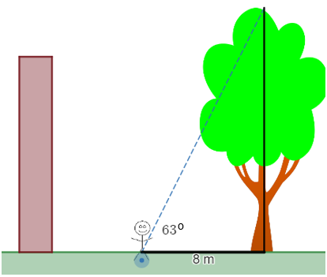
Larger and smaller angles – part 3
Explore
Predict the height of the tree.
How do you know?
Notes:
After completing the investigation around ${63}^{o}$ angles, ask students to predict the height of a tree in the scenario, where we know that we can see the height of the tree at a ${63}^{o}$ angle, and we have measured the distance to the foot of the tree to be 8m

Slide 5
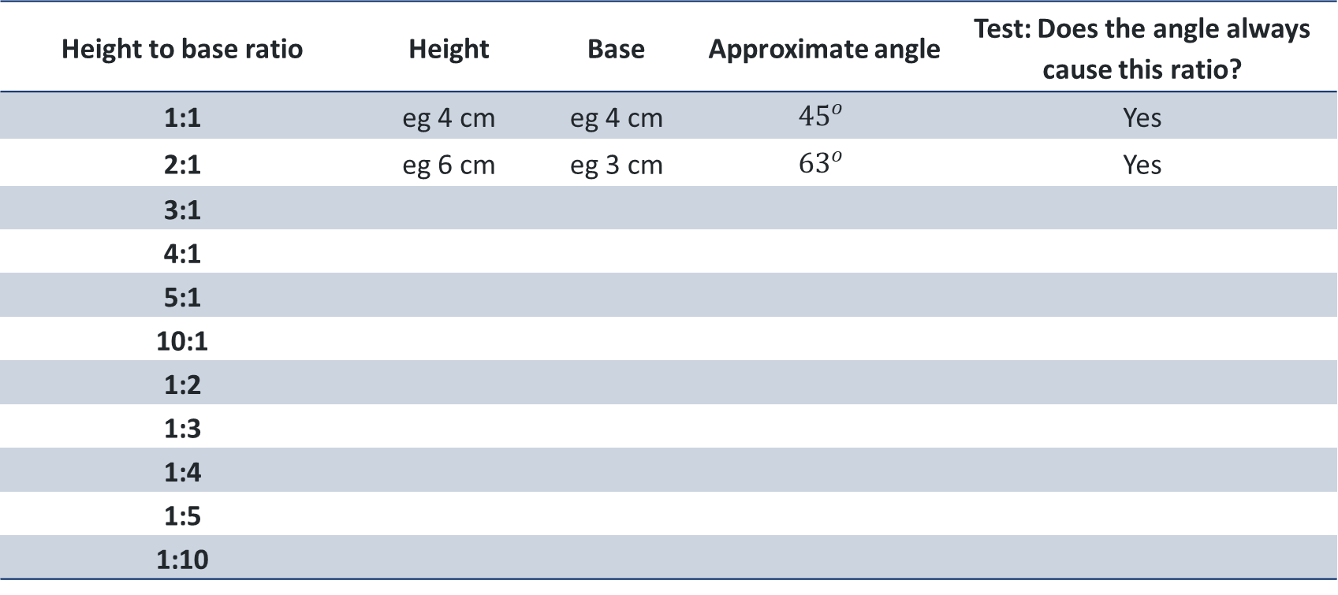
Larger and smaller angles – part 4
Explore
Height to base ratio | Height | Base | Approximate angle | Test: Does the angle always cause this ratio?
1:1 | eg 4 cm | eg 4 cm | $${45}^{o}$$ | Yes
2:1 | eg 6 cm | eg 3 cm | $${63}^{o}$$ | Yes
3:1
4:1
5:1
10:1
1:2
1:3
1:4
1:5
1:10
Notes:
Students repeat this process of drawing right angles measured to a specific ratio, and record the measured angle in the table below .

Slide 6
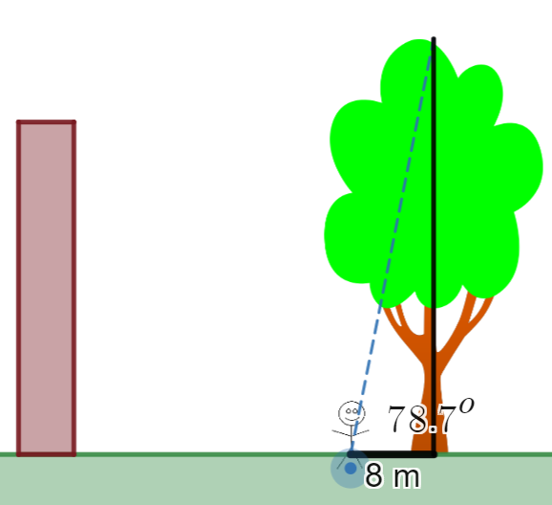
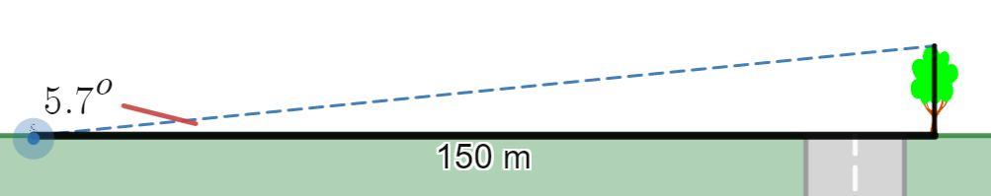
Larger and smaller angles – part 5
Explore
Predict the heights of the two trees shown.
Notes:
Challenge students to use their table to predict the heights of the two trees shown

Slide 7
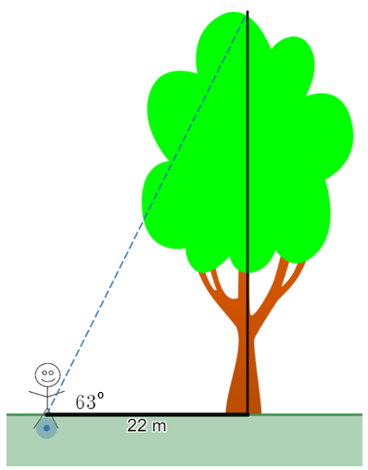
Larger and smaller angles – part 6
Summarise – Exit ticket
How tall is the tree?
How do you know?
Notes:
1. Students to engage in a think, pair, share (bit.ly/thinkpairsharestrategy) to consider what they have just found in the table from Appendix B.
Take this opportunity to question students on whether the ratios will be the same without the right angle.
2. Teacher to lead a discussion around significant conclusions from this investigation:
in every right-angled triangle with a given angle, the two sides that form the right angle will have a constant ratio.
we can use these ratios to find the heights of objects where we know the angle.
3. Have students write notes to their future self (bit.ly/notesstrategy) about these conclusions.
4. Students complete exit ticket (bit.ly/exitticketstrategy).

Slide 8
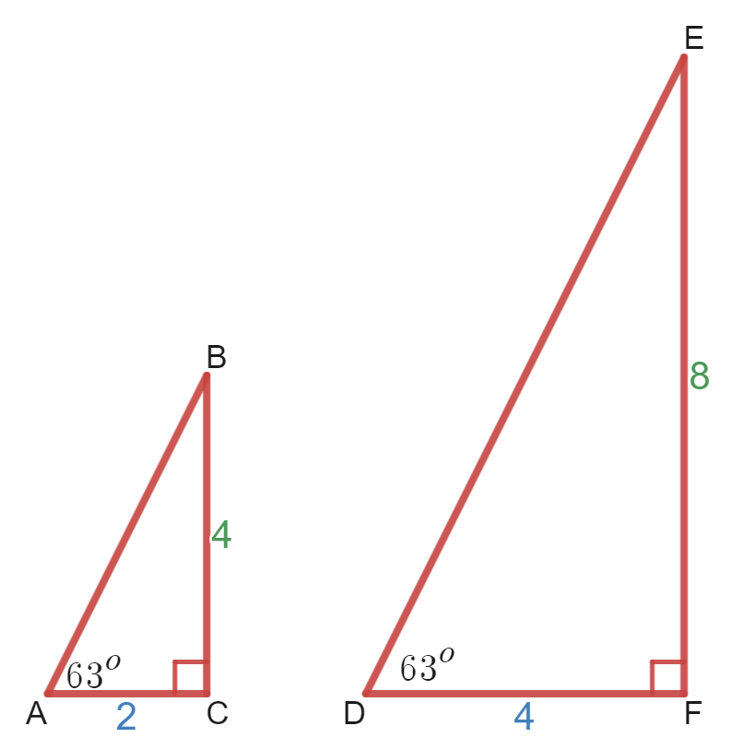
Larger and smaller angles – part 7
Summarise
How do you know that these triangles are similar?
Notes:
Students to engage in a Think, Pair, Share (bit.ly/thinkpairsharestrategy), considering the question "how can you tell that these triangles are similar?“
Lead a discussion connecting this conclusion of similarity to the previous topic regarding similar figures, and the minimum requirements for two triangles to be similar

Slide 9
Success criteria
I can use a clinometer to find positions that give desired angles towards tall objects.
I can use ratios in right-angled triangles to predict the heights of objects.

