Slide 1
The tangent ratio
Explicit teaching

Slide 2
The tangent ratio – part 1
Visible learning
Learning intentions
To be able to use language associated with trigonometry to describe right-angled triangles.
To know and be able to define the tangent ratio.
Success criteria
I can identify the hypotenuse, opposite and adjacent sides with respect to an angle in a right-angled triangle.
I can explain the relationship between the value of $\tan{{30}^{o}}$ found in my calculator and a right-angled triangle with a ${30}^{o}$ angle.
I can write the tangent ratio for a given angle in a right-angled triangle.

Slide 3
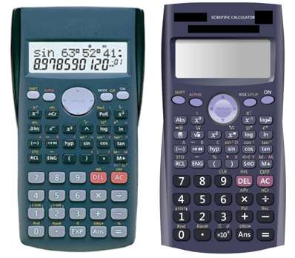
The tangent ratio – part 2
Launch
Look at your calculator with a partner.
Write down any of the buttons that you aren't sure what they do.
Think pair share
Notes:
Initiate a discussion using strategies such as Think, Pair, Share (bit.ly/thinkpairsharestrategy) asking students to:
Look at your calculator with a partner. Write down any of the buttons that you aren't sure what they do.
Reveal that the buttons on their calculator "sin", "cos" and "tan" relate to right-angled triangles and we are going to investigate what they mean.

Slide 4
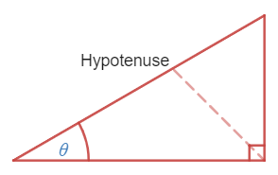
Labelling sides of right-angled triangles – part 1
Hypotenuse
Notes:
Hypotenuse: To find the hypotenuse, draw a straight line from the right angle and label the side you hit. An animation of this can be used with the Desmos graph, Hypotenuse (bit.ly/desmoshypotenuse ).

Slide 5
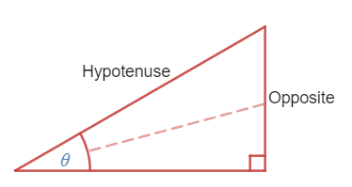
Labelling sides of right-angled triangles – part 2
Opposite
Notes:
Opposite means "on the other side". When you make an angle to form your triangle, there is one side that is not a part of your angle, and is sitting "on the other side" of the triangle. If you draw a straight line from your angle, you will hit the opposite side, as shown below. An animation of this can be used with the Desmos graph, Opposite side (bit.ly/desmosoppositeside).

Slide 6
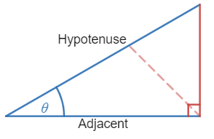
Labelling sides of right-angled triangles – part 3
Adjacent
Notes:
Adjacent means "next to" something. When we have measured an angle and formed our triangle, there are two sides that form our angle("next to" our angle). One of them is the hypotenuse, the other one should be labelled "adjacent", as shown below. An animation of this can be used with Desmos graph, Adjacent side (bit.ly/desmosadjacentside).
Students to practice labelling the sides of triangles in the activity at Transum website, Which side? (bit.ly/transumwhichside)

Slide 7
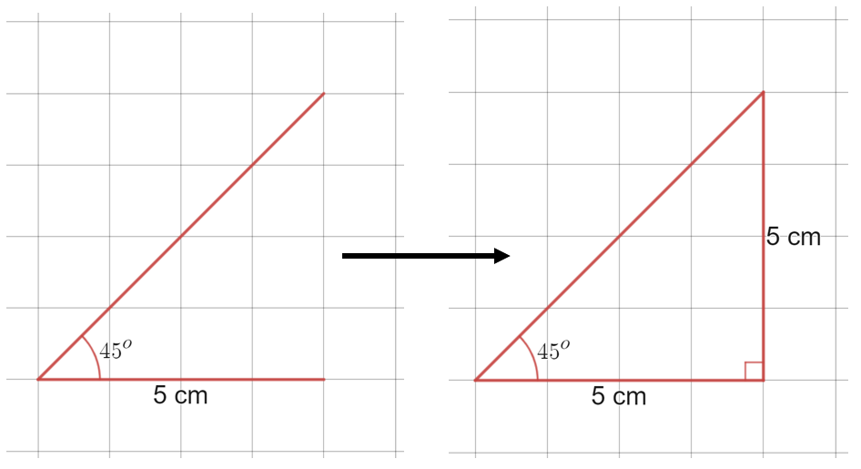
Turning a $45^{o}$ angle into a right-angled triangle
Summarise
Notes:
Ask students to use their protractors and rulers to each draw ${45}^{o}$ angles on a piece of grid paper, starting at the corner of any square and making one edge follow the gridline.
Students then use a right-angle to close the triangle along another gridline, as shown
Measure and label the sides.

Slide 8
Success criteria
I can identify the hypotenuse, opposite and adjacent sides with respect to a given angle in a right-angled triangle.
I can explain the relationship between the value of $\tan{{30}^{o}}$ found in my calculator and a right-angled triangle with a ${30}^{o}$ angle.
I can write the tangent ratio for a given angle in a right-angled triangle.

