Slide 1
The sine and cosine ratios
Explicit teaching

Slide 2
The sine and cosine ratios – part 1
Visible learning
Learning intentions
To be able to use language associated with trigonometry to describe features, properties and relationships within right-angled triangles.
To know and be able to define the trigonometric ratios of sine, cosine and tangent.
Success criteria
I can identify the hypotenuse, opposite and adjacent sides with respect to a given angle in a right-angled triangle.
I can explain the relationship between the value of sin30 found in my calculator and a right-angled triangle with a ${30}^{o}$ angle.
I can write three trigonometric ratios for a given angle in a right-angled triangle.

Slide 3
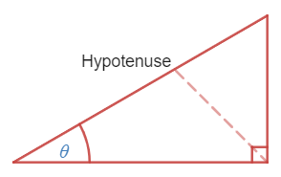
Trigonometric ratios – part 1
Hypotenuse
Notes:
Hypotenuse: To find the hypotenuse, draw a straight line from the right angle and label the side you hit. An animation of this can be used with the Desmos graph, Hypotenuse (bit.ly/desmoshypotenuse ).

Slide 4
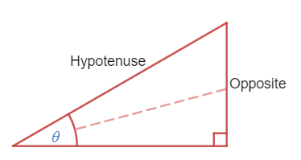
Trigonometric ratios – part 2
Opposite
Notes:
Opposite means "on the other side". When you make an angle to form your triangle, there is one side that is not a part of your angle, and is sitting "on the other side" of the triangle. If you draw a straight line from your angle, you will hit the opposite side, as shown below. An animation of this can be used with the Desmos graph, Opposite side (bit.ly/desmosoppositeside).

Slide 5
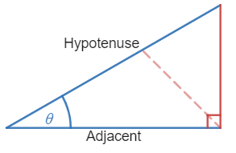
Trigonometric ratios – part 3
Adjacent
Notes:
Adjacent means "next to" something. When we have measured an angle and formed our triangle, there are two sides that form our angle("next to" our angle). One of them is the hypotenuse, the other one should be labelled "adjacent", as shown below. An animation of this can be used with Desmos graph, Adjacent side (bit.ly/desmosadjacentside).
Students to practice labelling the sides of triangles in the activity at Transum website, Which side? (bit.ly/transumwhichside)

Slide 6
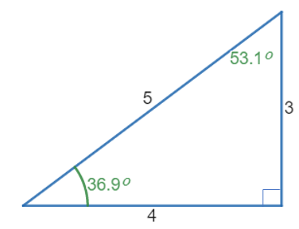
Trigonometric ratios – part 4
Summarise
What do you notice?
$$\sin{{36.9}^{o}}=\frac{3}{5}$$
$$\cos{{36.9}^{o}}=\frac{4}{5} \\ \tan{{36.9}^{o}}=\frac{3}{4} \\ \sin{{53.1}^{o}}=\frac{4}{5} \\ \cos{{53.1}^{o}}=\frac{3}{5} \\ \tan{{53.1}^{o}}=\frac{4}{3}$$
What do you wonder?
Notes:
Demonstrate to students how to write six ratios for a given triangle by constructing a right-angled triangle, measuring all angles and sides and recording them.
Ask students what they notice and what they wonder about the ratios they have found.
Have students construct one final right-angled triangle, measuring side lengths and angles, and write all six ratios. Are the things they noticed in your example true of every triangle?

Slide 7
Success criteria
I can identify the hypotenuse, opposite and adjacent sides with respect to a given angle in a right-angled triangle.
I can explain the relationship between the value of $sin30°$ found in my calculator and a right-angled triangle with a ${30}^{o}$ angle.
I can write three trigonometric ratios for a given angle in a right-angled triangle.

