Slide 1
Significant distances
Explicit teaching

Slide 2
Significant distances – part 1
Visible learning
Learning intentions
To appreciate the usefulness of significant figures in expressing very large measurements.
To be able to round very large numbers to a specified number of significant figures for comparison.
Success criteria
I can compare two very large numbers expressed to two significant figures.
I can round a very large number to any number of significant figures.

Slide 3
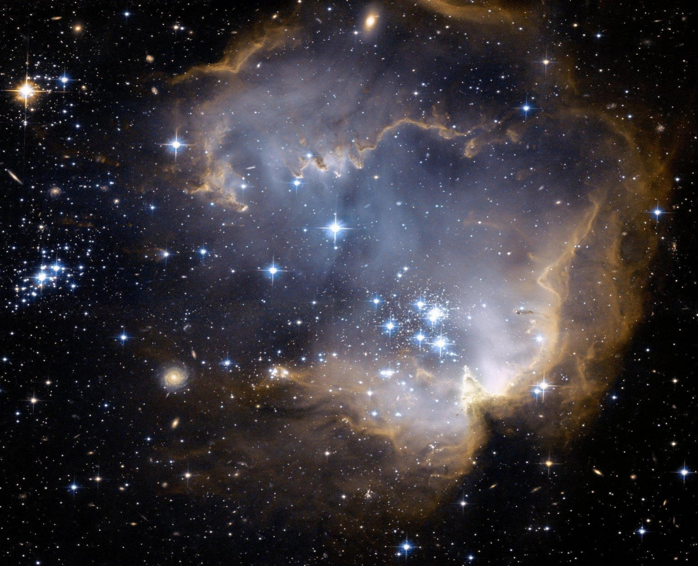
Significant distances – part 2
Launch
Notes:
Explain to students that this is an image of the sky taken from Earth. Have students think about the following two questions individually.
Which star do you think is the closest to Earth?
How do you know?
Ask students to engage in a Think/Pair/Share (bit.ly/thinkpairsharestrategy) discussing their answers to the questions.

Slide 4
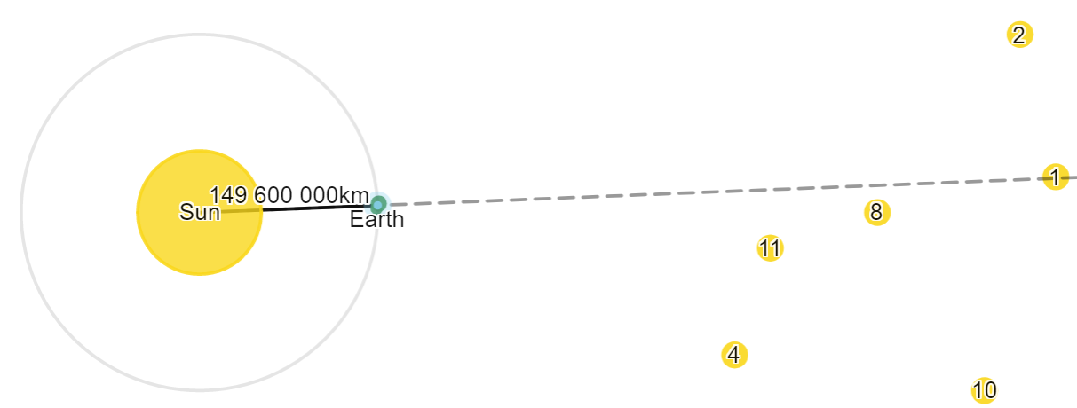
Forming a right angle
Explore
If we know the Earth is directly between the sun and a particular star right now, how can we know when the Earth, Sun and star form a right angle?
Notes:
Challenge students to consider how we can know when the Earth, Sun and star form a right angle if we know the Earth is directly between the Sun and star right now.

Slide 5
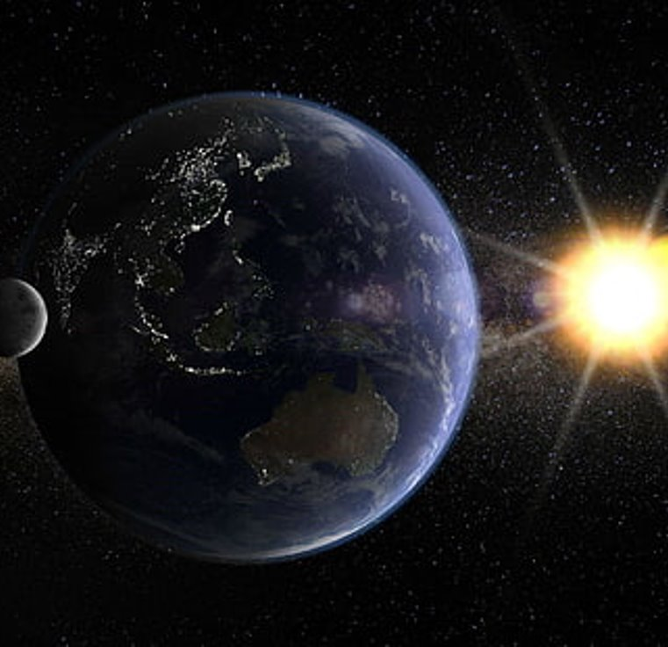
Identifying significant figures – part 1
How many significant figures?
Worked example
The distance from the Earth to the Sun is 149 600 000 km.
This measurement has 4 significant figures: 149 600 000
What are the significant figures in this question?
Why are they called significant?
The digits before all the zeroes on the end.
They tell us the size of the number.
Your turn
The distance from Earth to Mars is 54 600 000 km. How many significant figures is the measurement?
Three significant figures. 5, 4 and 6 are significant figures.
Notes:
Worked example
Reveal the question and its solution
Students read in silence
Students explain to themselves what is happening in the examples
Thumb up when finished reading
Explain to a partner
Answer self-explanation questions
Share answers with whole class
Your turn
Students now try this example on their own.
Give them time before revealing the answers.

Slide 6
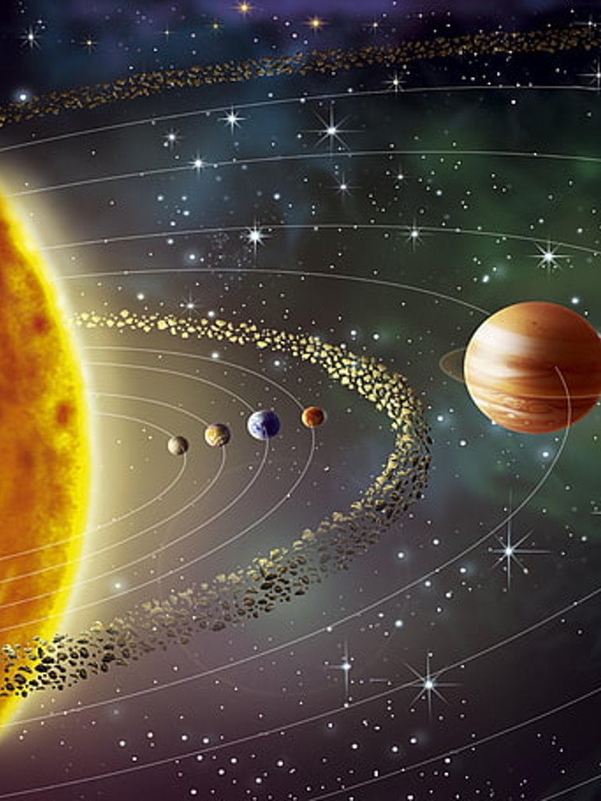
Identifying significant figures – part 2
How many significant figures?
Worked example
The distance from the Earth to the Sun is 150 000 000 km.
This measurement has 2 significant figures: 150 000 000.
Your turn
The distance from Earth to Neptune is 4 616 400 000 km. How many significant figures is this measurement?
5 significant figures. 4, 6, 1, 6 and 4 are significant figures.
Notes:
Worked example​
Reveal the question and its solution​
Students read in silence​
Students explain to themselves what is happening in the examples​
Thumb up when finished reading​
Explain to a partner​
Answer self-explanation questions​
Share answers with whole class​
​
Your turn​
Students now try this example on their own. ​
Give them time before revealing the answers. ​

Slide 7
Rounding with significant figures – part 1
Two significant figures
Worked example
The distance from the Earth to a star is measured to be 719 536 257 km.
Rounded to 2 significant figures, this becomes 720 000 000 km
Why are the digits to the left more significant?
How is it helpful to round these large numbers?
They represent a larger part of the number
They are more easily read and compared
Your turn
The distance from Earth to a star is 7 818 534 927 km. Round this measurement to 2 significant figures
7 800 000 000 km
Notes:
Worked example​
Reveal the question and its solution​
Students read in silence​
Students explain to themselves what is happening in the examples​
Thumb up when finished reading​
Explain to a partner​
Answer self-explanation questions​
Share answers with whole class​
​
Your turn​
Students now try this example on their own. ​
Give them time before revealing the answers. ​
​

Slide 8
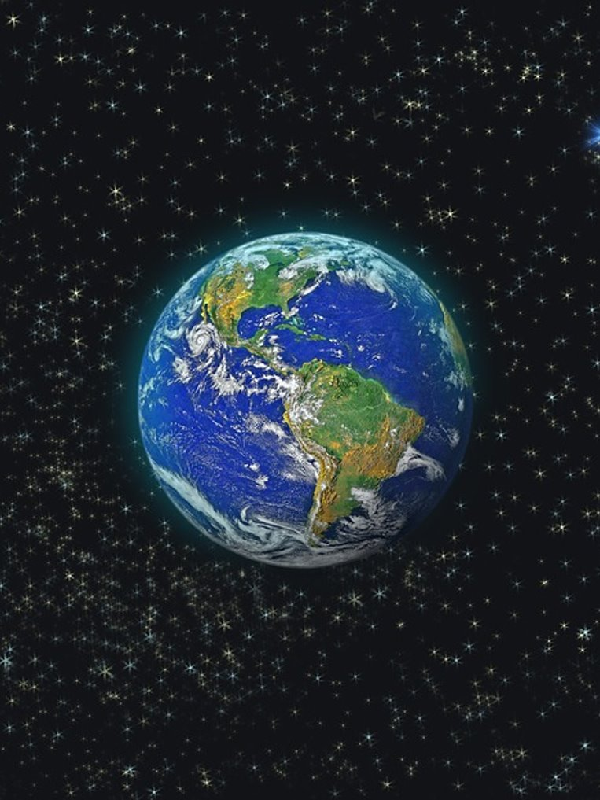
Rounding with significant figures – part 2
Rounding
Worked example
The distance from the Earth to Jupiter is measured to be 862 054 231 km.
Rounded to 3 significant figures, this becomes 862 000 000 km.
Your turn
The distance from Earth to Mercury is 209 514 372 km.
Round this measurement to 2 significant figures.
210 000 000 km
Notes:
Worked example​
Reveal the question and its solution​
Students read in silence​
Students explain to themselves what is happening in the examples​
Thumb up when finished reading​
Explain to a partner​
Answer self-explanation questions​
Share answers with whole class​
​
Your turn​
Students now try this example on their own. ​
Give them time before revealing the answers. ​

Slide 9
Success criteria
I can determine the number of significant figures in a measurement
I can round a number to a specified number of significant figures

