Slide 1
2024 HSC monitoring
Compliance and advice
Kate Thompson, Stage 6 Advisor

Slide 2
What is the context for HSC monitoring?
Rules and regulations – underpinned by the Education Act 1990
Effective and efficient processes.
Prioritise teaching time.
Reduce administrative burden.
NESA
Rules and regulations
ACE manual
Schools online
NESA
Syllabuses
Stronger HSC Standards
NESA
Registration for government school system
Department
Curriculum Policy Standards
Consultation is required to develop whole school negotiated processes and procedures’
Notes:
The information required for schools to successfully implement the HSC for all students comes from a range of sources and is underpinned by legislation. The requirements of these multiple sources have been synthesised in the HSC monitoring advice, with links to the source documents where necessary.
The HSC monitoring advice was written with a view to identifying essential processes, but with a sensitivity to teacher and NSWTF concerns about teacher workload.
NESA oversees the registration of all schools, including the NSW public school system. Feedback on this has highlighted the risk of schools teaching the wrong syllabus (old version) or setting the wrong number of assessment tasks and not timetabling indicative hours.
Public schools also need to comply with Department requirements. The department’s Curriculum planning and programming, assessing and reporting to parents K-12 policy, and associated standards document, set out the requirements for Life Ready as well as documentation to be retained. The policy has been updated in relation to requirements for additional studies (electives) in Stage 5, which includes the option for schools to deliver Department approved elective courses.
References:
Education Act: https://www.legislation.nsw.gov.au/#/view/act/1990/8/whole#%2Fpart8%2Fdiv2%2Fsec95
Educational Services Review: https://education.nsw.gov.au/about-us/strategies-and-reports/our-reports-and-reviews/educational-services-review

Slide 3
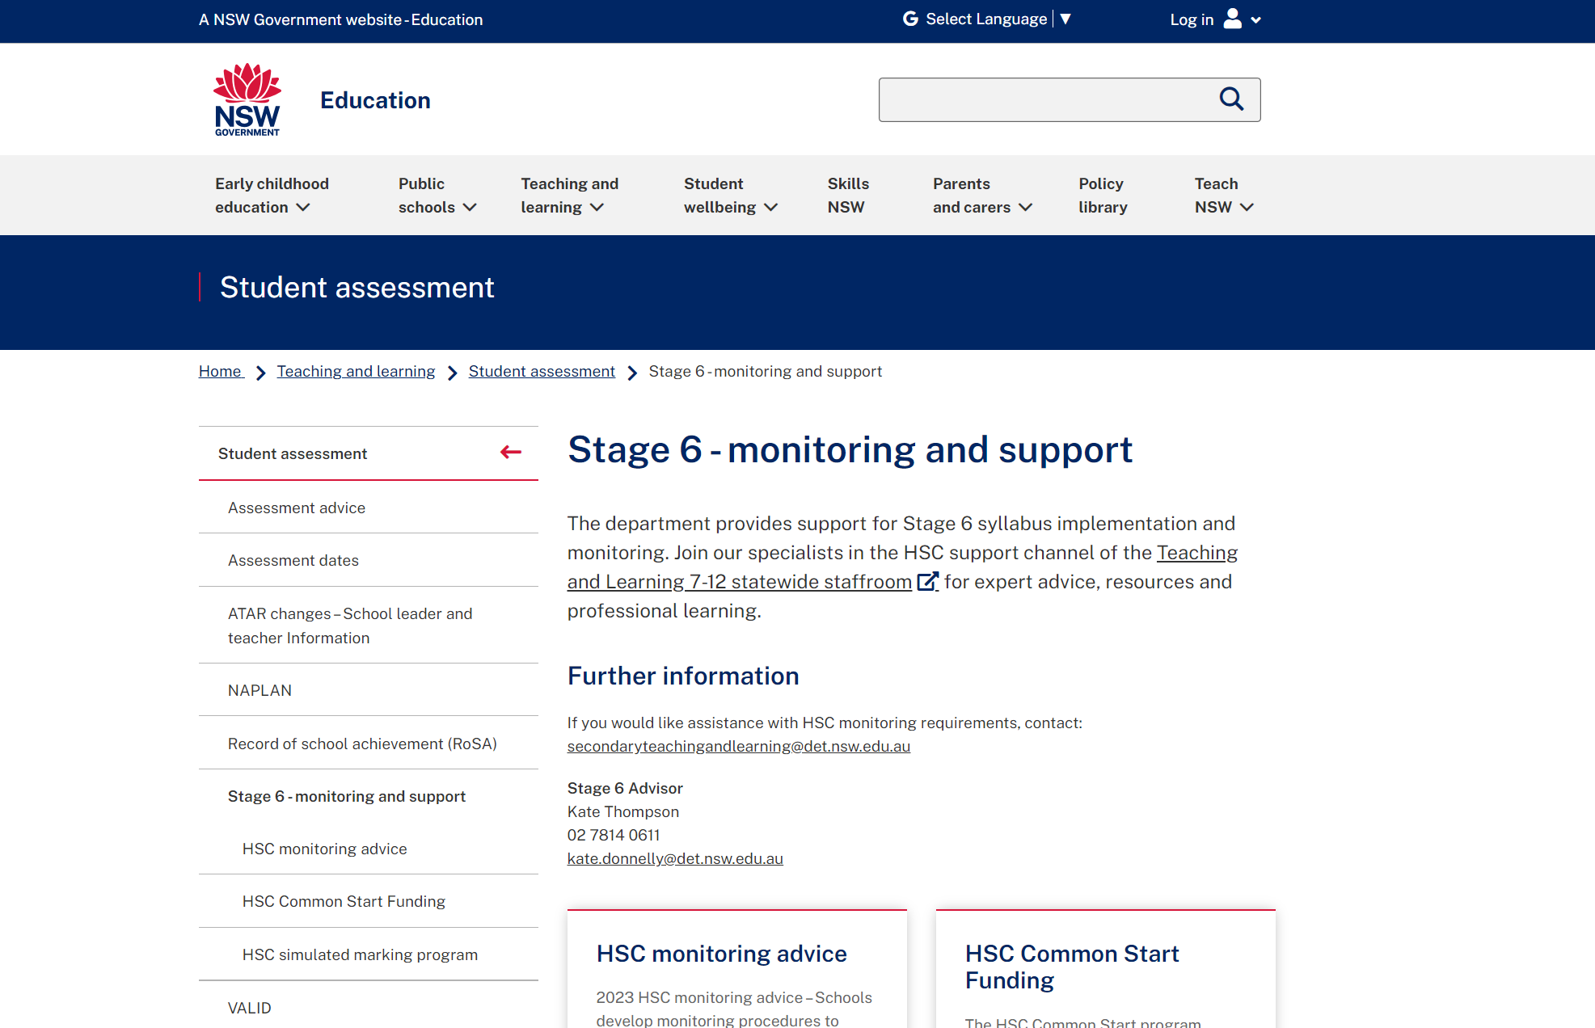
Department’s monitoring advice (1 of 2)
Communication
Published in Staff Noticeboard ​
Posted in Teaching and Learning 7–12 Statewide staffroom​
On Stage 6 web page
https://education.nsw.gov.au/teaching-and-learning/student-assessment/stage6
Notes:
The 2024 HSC Monitoring advice can be found at the web address on the slide.
The HSC monitoring advice is consolidated into one document is communicated in a variety of ways:
emailed to principals
published on Staff Noticeboard at the same time
it is available on the Stage 6 website (https://education.nsw.gov.au/teaching-and-learning/student-assessment/stage6)
it is also available in the Teaching and Learning 7-12 Statewide Staffroom (Link is https://teams.microsoft.com/l/team/19%3aDOa8hIqcuhl7tYigFta86DZAD2WAwR5gm-7eOLk1rhI1%40thread.tacv2/conversations?groupId=594ab959-8c37-4064-85a4-338da8518325&tenantId=05a0e69a-418a-47c1-9c25-9387261bf991)
The HSC advice is intended to:
assist senior executive, head teachers and teachers
help when consulting to develop whole school negotiated processes and procedures
to monitor the requirements for Year 11 and Year 12.
School processes should be time efficient and managed to support teachers, students and families. Variations in processes can and do exist, depending on school context.
​

Slide 4
Key changes for 2024
Summary
Contents page
Emphasised the need for genuine and meaningful negotiations about whole school processes
Reduced repetition and simplified wording throughout
Sub-section and link to document on requirements for timetabling indicative course time
Sub-section and link to document on preventing and managing malpractice in school-based assessment
Shifted maintenance of records content into Section 1 and revised the list of records required
Consolidated all requirements into Section 1, removed non-mandatory information such as best practice and responsibilities, to focus on key requirements
Removed sample timeline and linked to NESA’s 2024 timetable of actions in Section 1
Included more support for teachers with links to program templates and examples of electronic HSC monitoring
Changes to ATAR eligibility information
Simplified the Principal and DEL sign off in Section 3 (previously called Appendix 2)
Notes:
The advice has gone through a robust internal and external consultation process
A summary of changes will now be indicated on the first page of the HSC monitoring advice document when it’s published.
This year there have been significant changes to the document – but please know there are no additional requirements compared to previous years.
We are committed to simplifying requirements, reducing the length of the document, removing repeated information etc.
We are working to reduce teacher workload, eliminate unnecessarily administrative tasks and encourage schools to implement processes that are genuinely and meaningfully negotiated among staff so they are manageable and efficient.
I would also like to make it clear that NESA, the Department and NSWTF are aligned in that there is no expectation for HSC-style monitoring to take place in Stages 4 and 5.

Slide 5
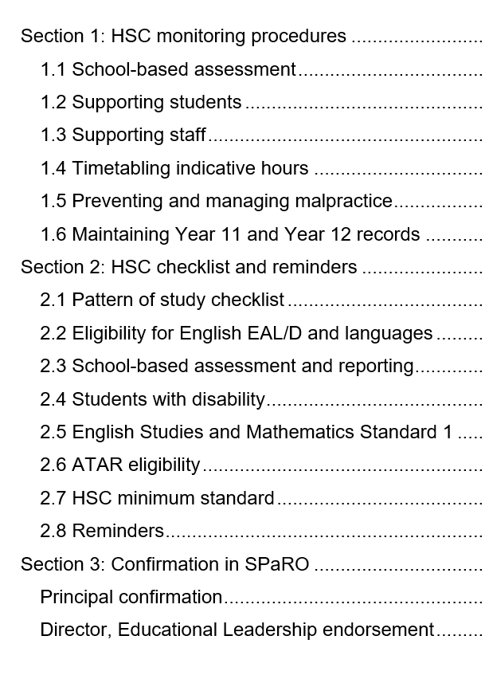
Department’s monitoring advice (2 of 2)
Content
3 sections contain essential information for the effective delivery and sign off for Stage 6 courses.
Section 1 – HSC monitoring procedures
Section 2 – HSC checklist and reminders
Section 3 – Confirmation in SPaRO
Notes:
The HSC monitoring advice is divided into 3 sections
Compliance with style guides and accessibility requirements
The HSC advice document now complies with department styles guides, accessibility guidelines and web publishing requirements so screen readers can accurately interpret the information.
SPaRO
The School Planning and Reporting Online (SPaRO) tool is used to collect data HSC monitoring data and HSC Teacher support data. SPaRO entries and sign-offs must be done by Principals and DELs 12 April for 2024 HSC
- In recognition of continuing disruption to schools, NESA has made changes to assessment for the HSC in 2024. These changes only apply to Year 12 students starting HSC courses in Term 4 2023, and sitting the corresponding HSC written exams in 2024. There is no flexibility with Year 11 school based assessment.
Reference:
ACE manual https://ace.nesa.nsw.edu.au/hsc-assessment-in-2024

Slide 6
HSC monitoring procedures (1 of 3)
School-based assessment
Schools are required to develop an assessment program for each of their HSC courses and provide students with written advice about the school’s requirements for assessment in each course.
Notes:
ACE rule 8072 is all about school-based assessment and requires schools to develop an assessment program for each of their HSC courses and provide students with written advice about the school’s requirements for assessment in each course.
The advice to students must be based on the ‘Assessment and Reporting’ requirements for corresponding syllabus and must include:​
the number of tasks and general nature of each task​
components and weightings in relation to the total weighted mark for the course​
a schedule of when assessment tasks are to take place, with adequate notice of the precise timing of each task​
procedures for marking, recording and reporting with provision for clear feedback to students on their performance. This includes attainment relative to outcomes and relative position in the school group.
Reference: https://ace.nesa.nsw.edu.au/ace-8072

Slide 7
HSC monitoring procedures (2 of 3)
Appropriate procedures
What is the timeframe for marking and returning assessments to students?
How explicit is feedback to students?
How and where are all assessment marks securely recorded?
How can you balance reliability and teacher workload when marking assessments?
What is your school’s approach to collecting work samples?
How do you deal with draft submissions?
Notes:
Procedures must be made clear in your school's assessment policy – this is so staff, students and parents are aware of what to expect.
This includes procedures for marking, recording and reporting with provision for clear feedback to students on their performance.
Take some time to discuss the questions on the slide. Please seek advice from the Stage 6 Advisor if unsure about anything. Email: secondaryteachingandlearning@det.nsw.edu.au
Reference: https://ace.nesa.nsw.edu.au/ace-8072

Slide 8
HSC monitoring procedures (3 of 3)
Administrative arrangements
Student appeals
Invalid or unreliable tasks
Late submission
Absence from an assessment task
N-determinations
Illness/ misadventure
Malpractice
Notes:
ACE rule 8072 also requires schools to include details of administrative arrangements such as absence from an assessment task, late submission of tasks, illness or misadventure, malpractice, invalid or unreliable tasks, student appeals arising from assessment tasks and non-completion (‘N’) determinations .
Schools needs really solid processes around each of these aspects. Many have an assessment committee/appeals committee, or equivalent, as a mechanism for independent decision-making.

Slide 9
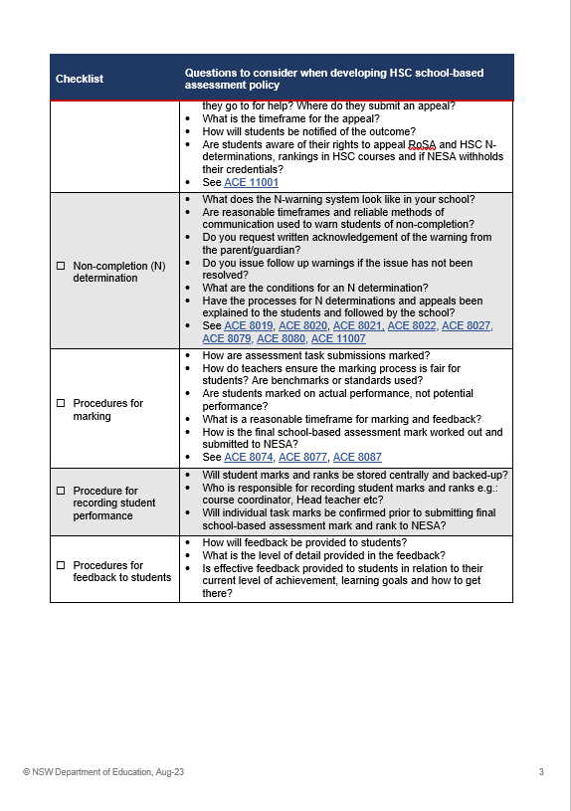
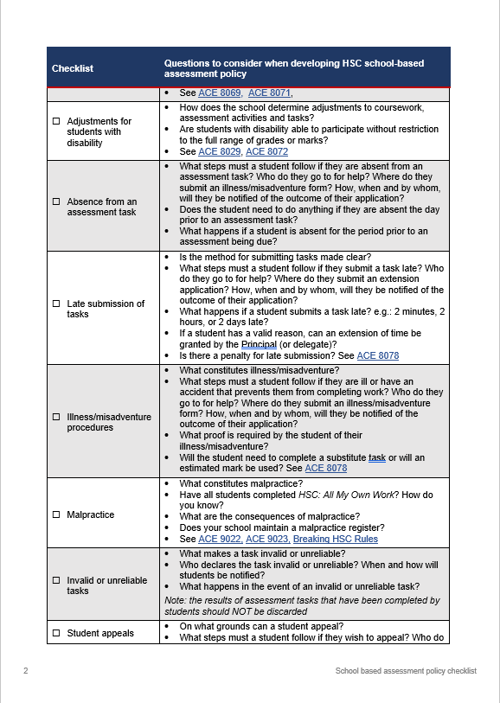
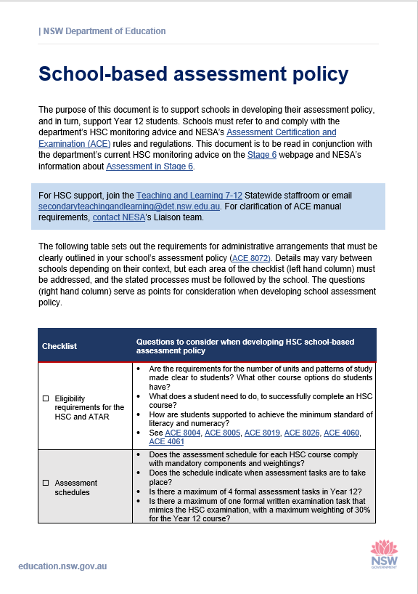
Checklist – school-based assessment policy
To assist schools
Notes:
The Teaching and Learning Team have developed an assessment policy checklist to help schools discuss and develop their own school-based assessment processes.
The document is available in the Teaching and Learning 7-12 Statewide staffroom. > HSC Support channel > Files
It’s framed in a way to promote discussion around processes, because every school has their own context. Your school staff, or representatives need to discuss and decide what is reasonable, what is fair and what best supports your students whilst adhering to ACE rules.
Link is https://teams.microsoft.com/l/team/19%3aDOa8hIqcuhl7tYigFta86DZAD2WAwR5gm-7eOLk1rhI1%40thread.tacv2/conversations?groupId=594ab959-8c37-4064-85a4-338da8518325&tenantId=05a0e69a-418a-47c1-9c25-9387261bf991

Slide 10
HSC monitoring (1 of 2)
To support students
Fulfil NESA requirements
Provide information
Explain information
Students use NESA Schools Online
More detail in the HSC monitoring advice
Notes:
The next part of the document is about what can be done to assist students.
Fulfil NESA requirements
Sign the declaration on the confirmation of entry
Complete HSC all my own work
Provide information (to students AND parents/carers)
Issue students with HSC Rules and Procedures
About HSC minimum standard
Course information, common practice is issuing the syllabus topic or depth study
Providing appropriate adjustments
Timely advice about disability provisions and how to apply – NESA liaison officers run multiple workshops on this
Checking compliance – eg: subject selection, drop a subject etc
Explain information to students
Assessment information / assessment policy
Approved patterns of study if seeking ATAR or HSC
Students NESA online
Check HSC subject entries, check personal information
Access exam papers and minimum standards tests
HSC results

Slide 11
HSC monitoring (2 of 2)
To support staff
Implement negotiated processes
Support students with disability
Ensure clear understanding
More detail in the HSC monitoring advice
Notes:
It is important that teaching staff are engaged in genuine and meaningful negotiations in relation to the school’s system of maintaining records.
Whole-school negotiated processes should support teaching and learning, and reduce administrative workload, while ensuring requirements can still be met.
Other considerations include:
Consistency in staff understanding of school processes
Support from senior executive
Professional learning

Slide 12
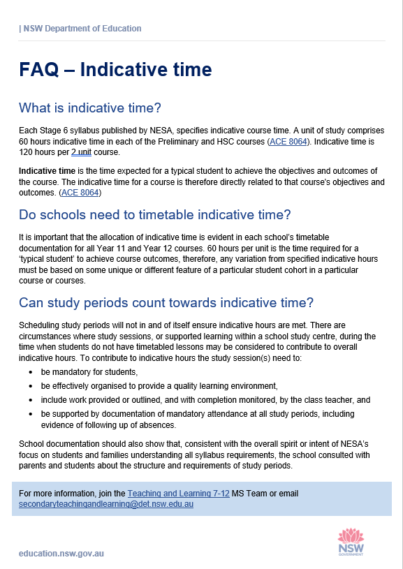
FAQ – Indicative time
To assist schools
Notes:
2024 continues to see the monitoring of an existing expectation in relation to indicative course time.
The Department requires the allocation of indicative course time to be evident in each school’s timetable documentation for all Year 11 and Year 12 courses. 60 hours per unit is the time required for a ‘typical student’ to achieve course outcomes, therefore, any variation from specified indicative hours must be based on some unique or different feature of a particular student cohort in a particular course or courses.
Further guidance on FAQ - Indicative time.docx
The file can be found in the Microsoft Team called Teaching and Learning 7-12 > HSC support channel > files
Link to team is:
https://teams.microsoft.com/l/team/19%3aDOa8hIqcuhl7tYigFta86DZAD2WAwR5gm-7eOLk1rhI1%40thread.tacv2/conversations?groupId=594ab959-8c37-4064-85a4-338da8518325&tenantId=05a0e69a-418a-47c1-9c25-9387261bf991

Slide 13
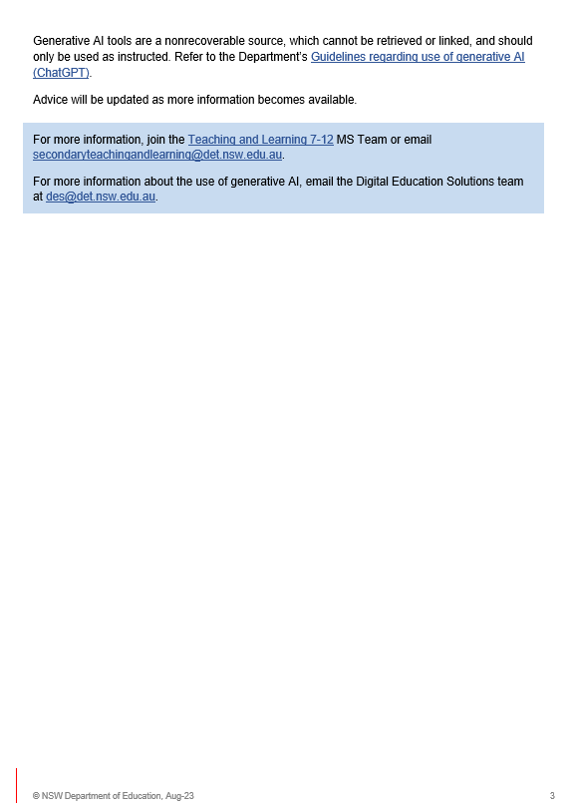
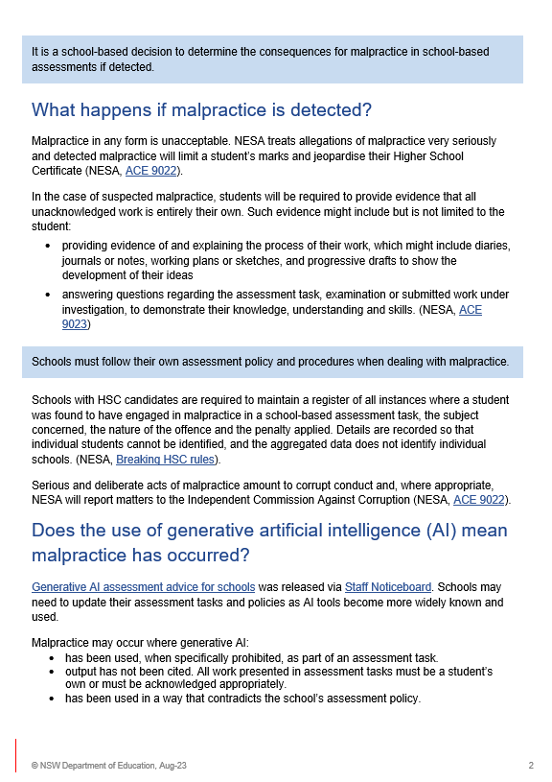
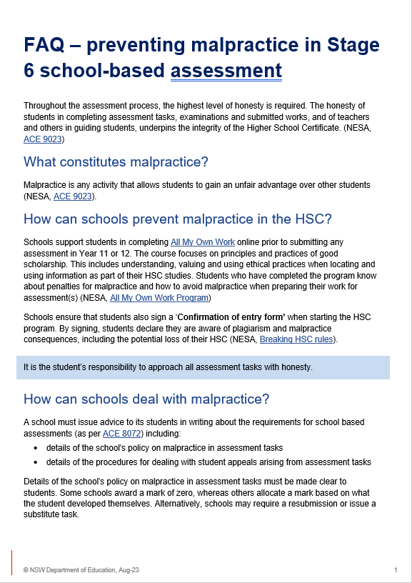
FAQ – managing malpractice
To assist schools
Notes:
A new inclusion for HSC monitoring is about malpractice.
Details of the school's policy on malpractice in assessment tasks must be made clear to students.
The FAQ document shown on the slide aims to help answer some questions about how to prevent malpractice and deal with it if detected.
It brings together NESA requirements and processes associated with malpractice.
The document is available in the Teaching and Learning 7-12 Statewide staffroom > HSC Support channel > Files

Slide 14
Maintenance of records
What to keep
Keep records centrally (or in faculties), securely and backed up
supports any prolonged or unexpected teacher absence
recommend electronic HSC monitoring
avoid needless duplication
avoid unnecessary creation of hard copies
see the illustrations (examples) of practice
more detail in HSC monitoring advice document
Notes:
Records should be kept centrally, or in faculties and be accessible to both teachers and the school executive.
Only one set of records is required. Duplication or unnecessary creation of hard copies should be avoided.
There is no requirement to undertake HSC-style monitoring in Stages 4 and 5.
(NOTE: there are different timeframes for different documents. Information is available https://education.nsw.gov.au/inside-the-department/information-management-for-schools/documents-and-records/retention-schedules-for-documents-and-records
Many schools already have a list of what they require at a faculty level each term. Just cross-check this with pages current HSC monitoring advice document.

Slide 15
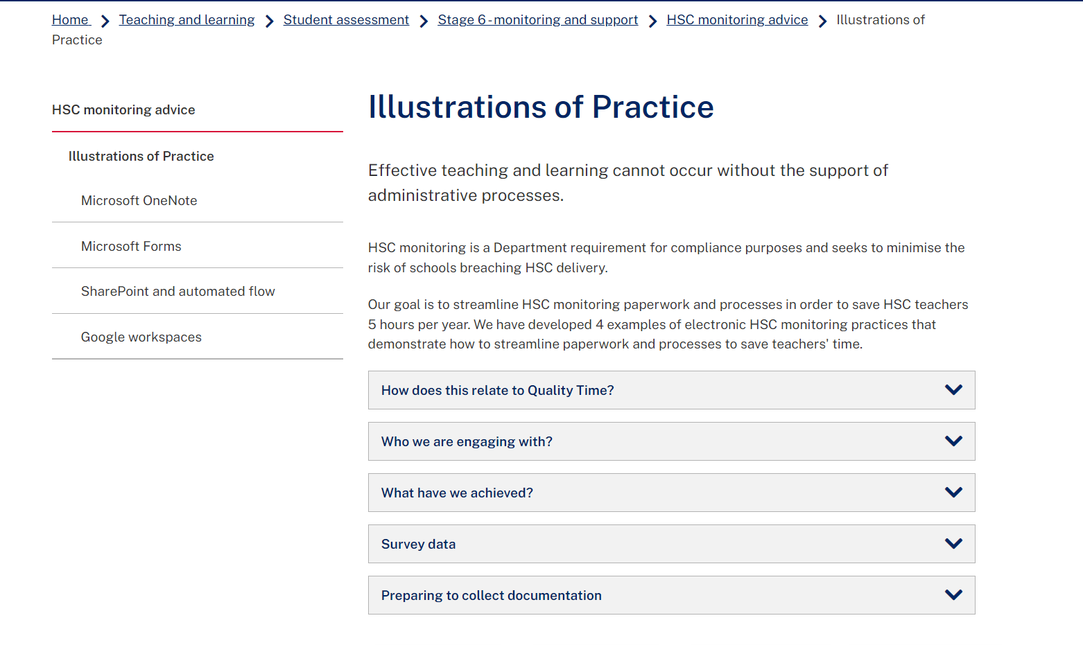
Streamlining administrative processes
Quality Time program
https://education.nsw.gov.au/teaching-and-learning/student-assessment/stage6/HSC-monitoring-advice/illustrations-of-practice
Notes:
The Quality Time program sought to simplify and modernise administrative processes and practices, to ensure that teacher and school leader time is spent on the work that matters most and best supports quality teaching and learning. Data collection and analysis (of which HSC monitoring was a part) gives schools important evidence to support the effective delivery of educational programs. It was 1 of 6 opportunity areas identified by teachers.
We engaged four schools to develop and publish their approach to electronic monitoring practices. The examples demonstrate improved ways to store, find and share HSC monitoring information

Slide 16
Illustrations of practice
Examples of how to maintain records
HSC monitoring
Example 1
OneNote
Example 2
Microsoft Forms
Example 3
SharePoint and automated flows
Example 4
Google workspaces
Notes:
Both NESA and the DoE allow electronic records to be kept. There is NO requirement to keep paper-based records.
Efficient use of electronic systems is encouraged. 4 examples are provided and thanks to the wonderful and generous people who contributed their ideas and worked for many days on the examples.
OneNote – from Concord HS
MS Form – form Aurora
Sharepoint and automated flows – from West Wallsend HS
Google workspaces – Jamieson HS
The 2 in red shades you can use straight away – these are able to be copied, downloaded and adjusted as needed.
The 2 in blue shades require more thinking and represent a holistic approach to faculty management

Slide 17
Checklist and reminders
Compliance with ACE rules
Pattern of study requirements
Eligibility for EAL/D and languages
School-based assessment and reporting
Students with disability
English Studies and Mathematics Standard 1
ATAR eligibility
HSC minimum standard
Student wellbeing
CPPAR K–12 policy and associated standards
Communicating to parents
Notes:
Records should be kept centrally, or in faculties and be accessible to both teachers and the school executive.
Only one set of records is required. Duplication or unnecessary creation of hard copies should be avoided.
There is no requirement to undertake HSC-style monitoring in Stages 4 and 5.
(NOTE: there are different timeframes for different documents. Information is available https://education.nsw.gov.au/inside-the-department/information-management-for-schools/documents-and-records/retention-schedules-for-documents-and-records
Many schools already have a list of what they require at a faculty level each term. Just cross-check this with pages current HSC monitoring advice document.

Slide 18
Support available
Stage 6
ACE rules and requirements
HSC monitoring advice
HSC Common Start funding
HSC simulated marking program
HSC Illustrations of practice
For networks of schools
School queries – parents, teachers, HTs, Principals, DELs
Teaching and Learning 7–12 Statewide staffroom
Notes:
The teaching and learning team deal with so much more than what is on the screen and are more than happy to help.
Please feel free to contact us (see details on next slide)

Slide 19
Contact
Teaching and Learning 7–12 team
secondaryteachingandlearning@det.nsw.edu.au

Slide 20
Copyright
© State of New South Wales (Department of Education), 2023
The copyright material published in this resource is subject to the Copyright Act 1968 (Cth) and is owned by the NSW Department of Education or, where indicated, by a party other than the NSW Department of Education (third-party material).
Copyright material available in this resource and owned by the NSW Department of Education is licensed under a Creative Commons Attribution 4.0 International (CC BY 4.0) licence.
This licence allows you to share and adapt the material for any purpose, even commercially.
Attribution should be given to © State of New South Wales (Department of Education), 2023.
Material in this resource not available under a Creative Commons licence:
the NSW Department of Education logo, other logos and trademark-protected material
Material owned by a third party that has been reproduced with permission. You will need to obtain permission from the third party to reuse its material.
Links to third-party material and websites
Please note that the provided (reading/viewing material/list/links/texts) are a suggestion only and implies no endorsement, by the New South Wales Department of Education, of any author, publisher, or book title. School principals and teachers are best placed to assess the suitability of resources that would complement the curriculum and reflect the needs and interests of their students.
If you use the links provided in this document to access a third party’s website, you acknowledge that the terms of use, including licence terms set out on the third-party’s website apply to the use which may be made of the materials on that third-party website or where permitted by the Copyright Act 1968 (Cth). The department accepts no responsibility for content on third-party websites.

